Slide 1
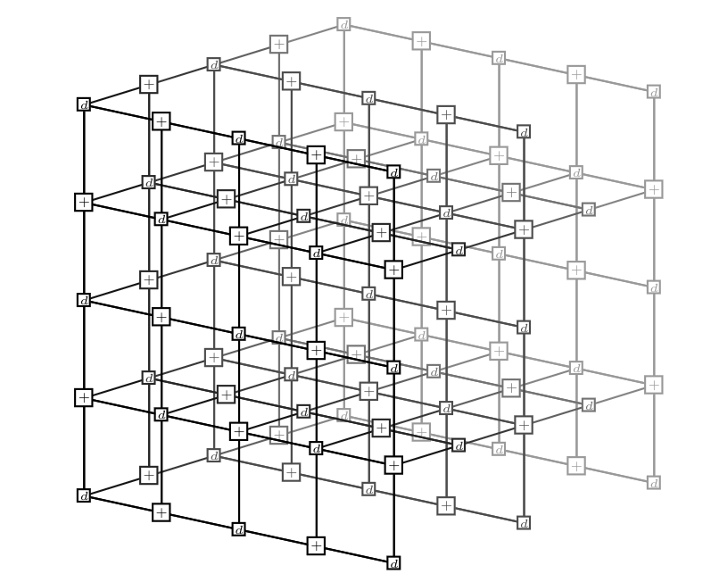
Tensor Network Decoding Beyond 2D
Quantum Information Theory Group
Institute for Theoretical Physics
Christophe Piveteau, Christopher Chubb, Joseph M. Renes
arXiv: 2310.10722
Notes:
Updated 30.10.

Slide 2
Tour of recent results in the group
.
Speed
BP+ guided decimation decoding: 2403.18901; A. Gong, S. Cammerer, JMR
Graph neural network: 2310.17758; A. Gong, S. Cammerer, JMR
PW quantum polar codes + SCL decoding:
2403.18901; A. Gong & JMR
Accuracy
Decoding tradeoff
3D tensor network decoding: this talk

Slide 3
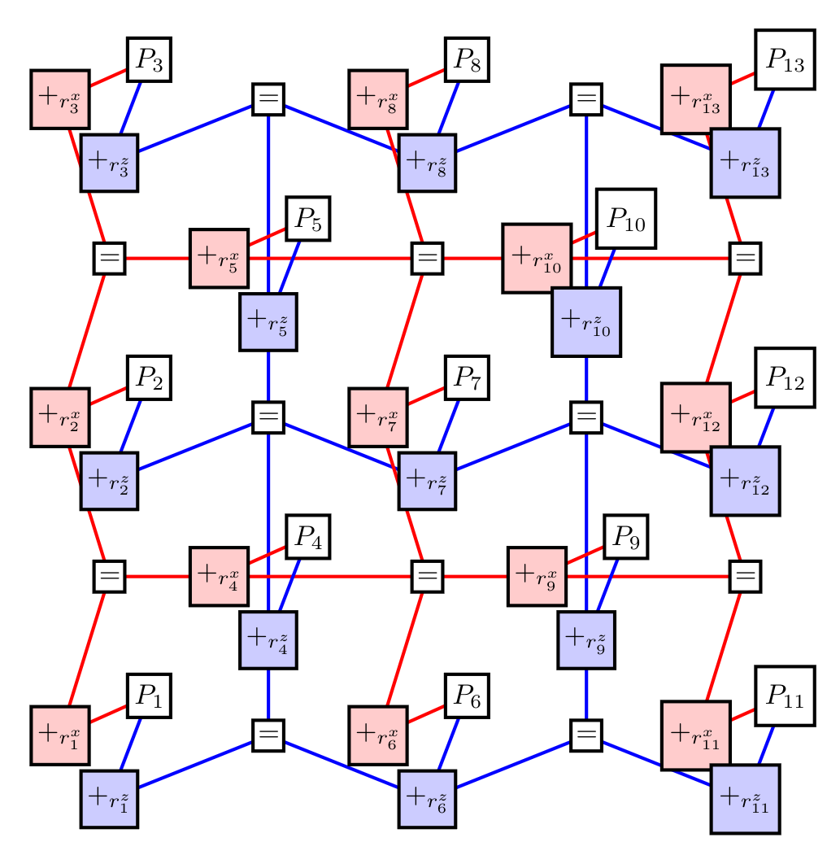
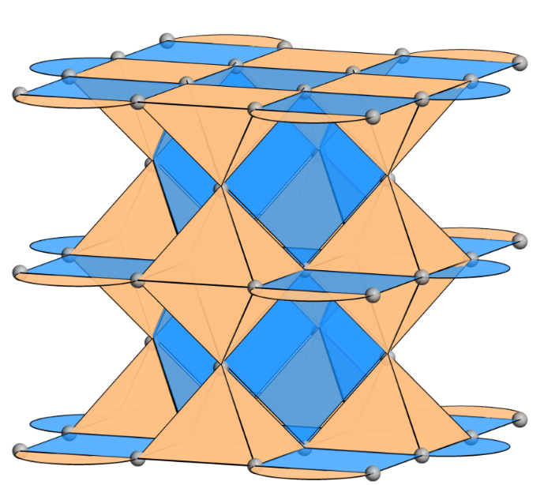
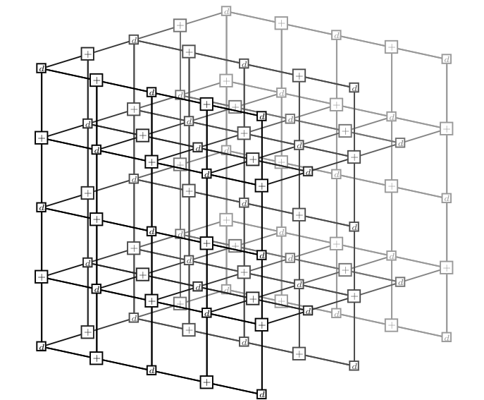
Focus today: 2D and 3D local codes
Code
TN used in decoding
TN Decoder performance
Works very well out-of-the-box!
$⟹$ essentially optimal decoding
(Bravyi et al. 2014, Chubb 2021)
2D
?
3D
Seems more difficult
Important for 2D+circuit level noise
[1]
[1]: Huang et al., PRX Quantum 4, 030338 (2023)
Notes:
Some codes are called called 2D or 3D codes
If you lay out qubits in 2d or 3d space, then the stabilizer only involve local qubits
TN will contain nodes for each qubit and stabilizer. If you do it right, the TN will preserve that locality

Slide 4
Overview of this talk
Representing optimal decoding as TN contraction
Tensor networks
Detector and generator pictures
Speed-Accuracy Tradeoff for 2D codes
Approximate contraction
Accurate & fast regimes
Going from 2D to 3D
Approximate contraction and why it’s harder than 2D
2D code with circuit-level noise

Slide 5
Optimal decoding as TN contraction

Slide 6
What are Tensor Networks?
$$A$$
scalar with value $A$
Tensors = multi-dimensional arrays
$$B$$
i
vector with entries $B_{i}$
i
$$C$$
j
matrix with entries $C_{ij}$
i
$$D$$
j
rank-3 tensor with entries $D_{ijk}$
k
…
Connection between two nodes implies contraction
$$≅\sum_{j=1}^{M}{A_{ij}B_{jk}}$$
i
$$A$$
j
$$B$$
k
bond dimension = M
Notes:
For my presentation we’re actually not going to exactly understand in detail
We’re not using the physicists’ meaning of a tensor (as used in Einstein’s theory of relativity) but more the computer scientists def

Slide 7
What are Tensor Networks?
C
n
i
D
p
m
A
k
j
B
$$\sum_{i}{\sum_{j}{\sum_{k}{\sum_{n}{A_{ijm}B_{jk}C_{ikn}D_{np}}}}}$$
Graphical Representation of sums of products
Notes:
For my presentation we’re actually not going to exactly understand in detail how TNs work.
I just want you to get the gist of the idea, namely XXX
Note: each index may show up at most in 2 tensors, and exactly those indices are summed over
Note: connecting two nodes implicity implies contraction

Slide 8
Optimal decoding
Assumptions:
Stabilizer code$𝒮=\left\langle S_{1},…,S_{n−k}\right\rangle ⊂P_{n}$
Pauli noise: error $e∈P_{n}$ with probability $Pr\left[e\right]$
$ℰ_{m}≔$Pauli errors that cause syndrome m
most likely error decoding
$$\underset{e∈ℰ_{m}}{argmax}{Pr\left[e\right]}$$
most likely error class decoding
$$\underset{\overline{e}∈ℰ_{m}/𝒮}{argmax}{Pr\left[\overline{e}\right]}$$
doesn’t take into account degeneracy
$$Pr\left[\overline{e}\right]=\sum_{e∈\overline{e}}{Pr\left[e\right]}$$

Slide 9
Tensor Network Construction
Assume noise model factorizes into local terms, e.g.
$$Pr\left[e\right]=P_{1}\left[e_{1}\right]⋅P_{2}\left[e_{2}\right]⋅…⋅P_{n}\left[e_{n}\right]$$
most likely error class decoding
$$\underset{\overline{e}∈ℰ_{m}/𝒮}{argmax}{\sum_{e∈\overline{e}}{Pr\left[e\right]}}$$
Sum of product terms
$⟹$ represent as TN
TN decoder procedure:
Build this TN for each error class
Contract all TNs
Pick most probable error class for correction

Slide 10
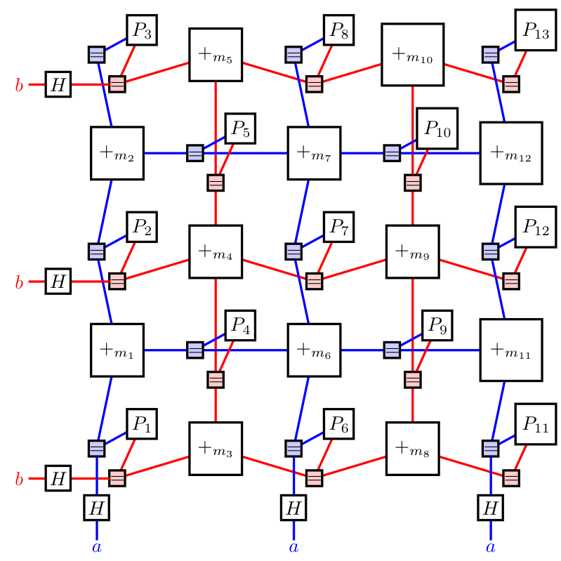
Two “dual” TN representations
Generator picture
Detector picture
representative error
$$Pr\left[\overline{e}\right]=\sum_{s∈𝒮}{Pr\left[es\right]}$$
$$Pr\left[\overline{e}\right]=\sum_{e∈P_{n}}{Pr\left[e\right]{⋅Ι}_{e causes syndrome m}{⋅Ι}_{e is in logical class \overline{e}}}$$
Notes:
This is all kinda vague – that is because it’s quite technical and the devil is in the details
In fact, there is not one “natural” way to really construct the TN
We argue that there are 2 ways, which can be seen as the dual of each other
In fact, we observe in practice that it can matter which one you pick

Slide 11
Decoding
Tensor Network Contraction
1312.4578 (Ferris, Poulin): TN from encoding circuit
1405.4883 (Bravyi, Suchara, Vargo): specific to 2D surface code
1801.01879 (Darmawan, Poulin): for non-Pauli noise
1809.10704, 2101.04125 (Chubb, Flammia): via statistical mechanical mapping
1708.08474,1907.02554 (Tucket et al.): modification of 1405.4883
2212.05071 (Darmawan): for random local log-depth Clifford encoding, from encoding circuit
2022, Bohdanowicz PhD thesis: for circuit-level noise, from history code
Nature 614, pages 676–681 (Google): for circuit-level noise, from decoding hypergraph
detector picture TN
generator picture TN

Slide 12
Two “dual” TN representations
Generator picture
Detector picture
representative error
$$Pr\left[\overline{e}\right]=\sum_{s∈𝒮}{Pr\left[es\right]}$$
$$Pr\left[\overline{e}\right]=\sum_{e∈P_{n}}{Pr\left[e\right]{⋅Ι}_{e causes syndrome m}{⋅Ι}_{e is in logical class \overline{e}}}$$
Notes:
This is all kinda vague – that is because it’s quite technical and the devil is in the details
In fact, there is not one “natural” way to really construct the TN
We argue that there are 2 ways, which can be seen as the dual of each other
In fact, we observe in practice that it can matter which one you pick

Slide 13
Hadamard trick
In detector picture: High weight check nodes for logical operators
H
=
H
Tensor
Network
+
Tensor
Network
=
H
H
H
H

Slide 14
Hadamard trick (2)
H
H
a
H
=
H
a
Tensor
Network
=
a
Tensor
Network
H
H
a
H
H
a
a
H
H

Slide 15
Speed-Accuracy Tradeoff for 2D codes

Slide 16
Contracting 2D Tensor Networks
(TN contraction animation)

Slide 17
Accuracy speed trade-off
fast
accurate
Approximation parameter: max bond dimension

Slide 18
2D TN Decoding Results
fast
accurate
Max bond dimension ~ 20-64
Source: Chubb, arXiv: 2101.04125

Slide 19
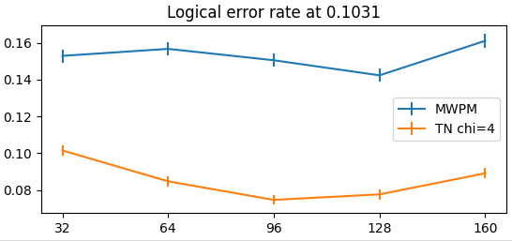
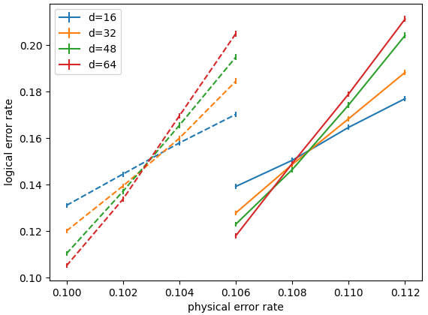
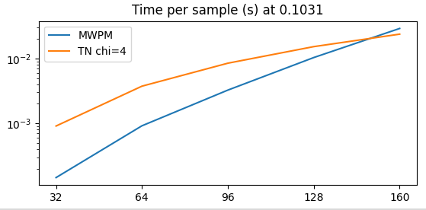
2D TN Decoding Results
fast
accurate
Max bond dimension of 4 already gives good results
Algorithmic improvement for contraction speed
For large d: beat PyMatching2 in speed&accuracy
MWPM
TN decoder
distance
distance

Slide 20
Going from 2D to 3D

Slide 21
Contracting 3D Tensor Networks
(TN contraction animation)

Slide 22
Why is 3D TN contraction harder?
Truncation of intermediate state:
cutting edge doesn’t separate into 2 partitions
Optimal low-rank approximation using truncated SVD
Notes:
For simplicity: assume again cubic TN
=> Cant do Schmidt decomp
=> intuitively: correlation between sites can be carried over many different bonds, not unique

Slide 23
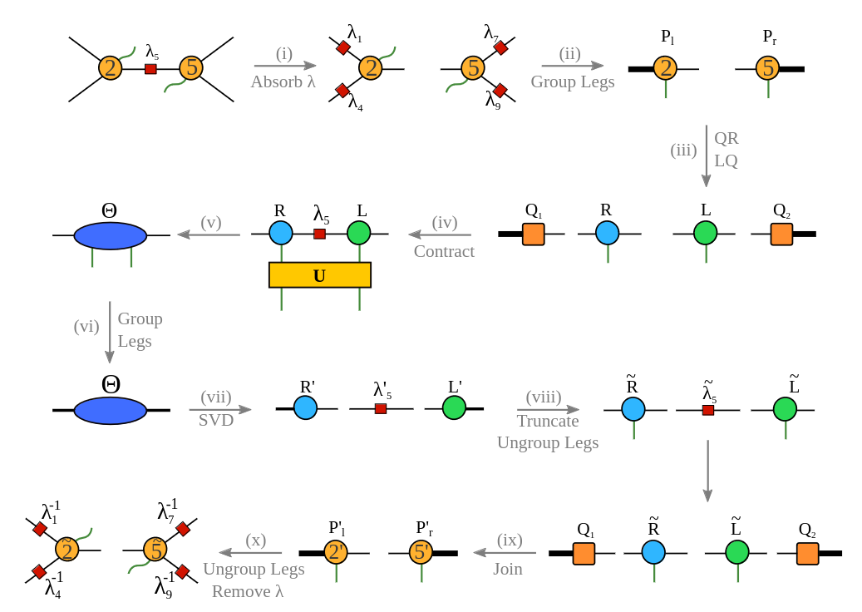
Simple-Update Method
We use “simple-update” method: keep rank-1 approximation of environment on each tensor

Slide 24
Results on 3D surface code
bit flip noise
phase flip noise
depolarizing noise
physical error rate
physical error rate
physical error rate

Slide 25
Circuit-level noise
Repeat syndrome measurement circuit ~d times
Mathematical model to capture noisy syndrome circuits and how errors spread:
Detector error model (Gidney, 2021) aka decoding hypergraph (Chen et al, 2021)
Time
Decoding problem can be expressed as decoding a classical linear code
[1] Barber et al., arXiv: 2309.05558

Slide 26
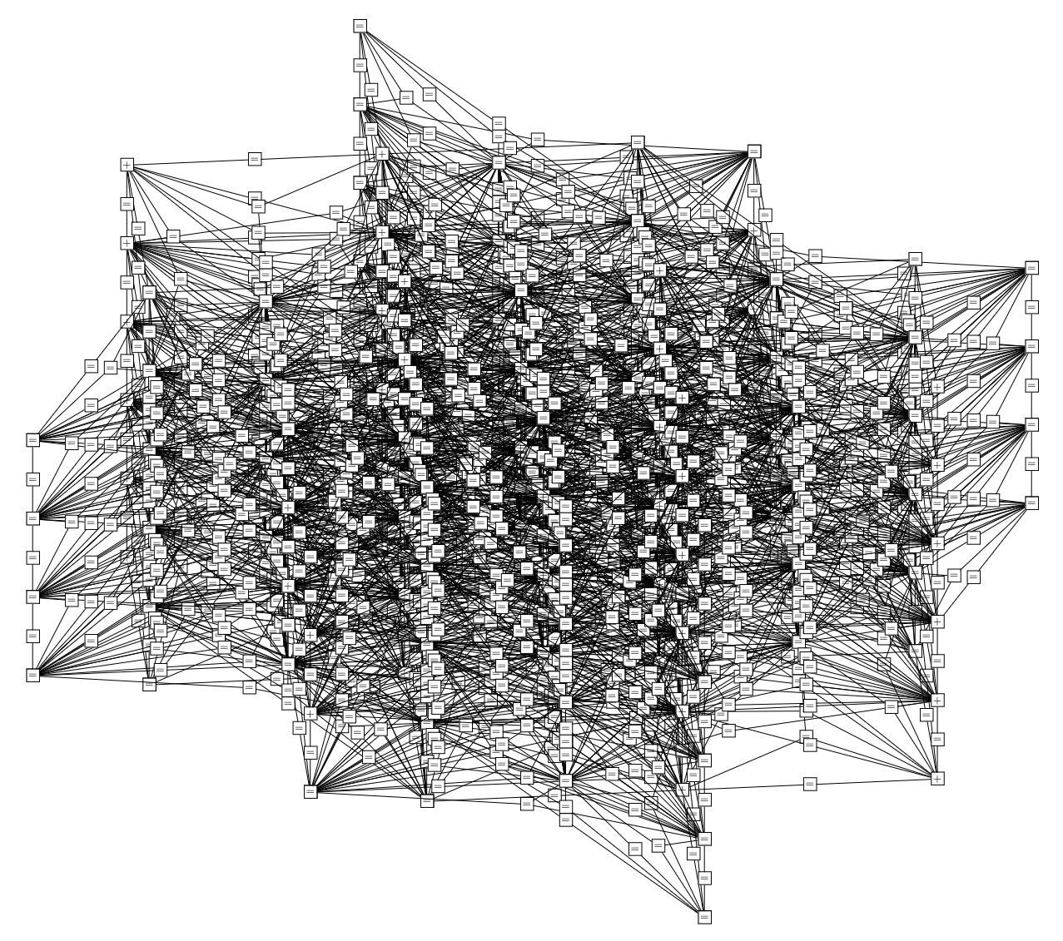
Tensor Network for 5x5 rotated surface code

Slide 27
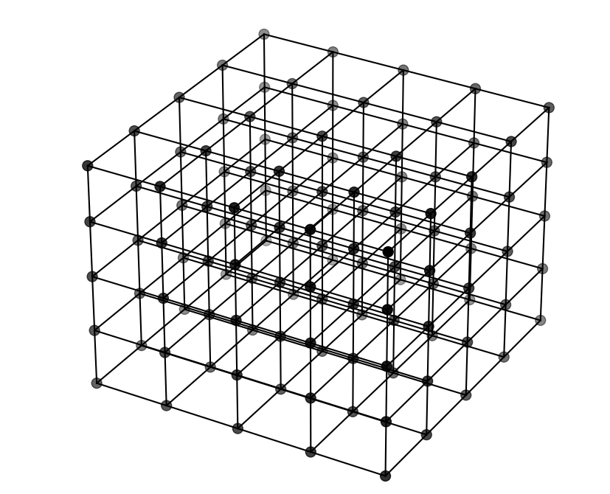
General strategy
Pre-compress huge tensor network into cubic tensor network
pre-compression very expensive, but only needs to be done once offline

Slide 28
Results
Rotated surface code with circuit-level depolarizing noise

Slide 29
Conclusion
TN construction: “generator” and “detector” picture
Decoding 2D codes: works amazingly well “out of the box”
Can be both accurate and fast
Decoding 3D codes: much harder, but still possible
2D code + circuit level noise: even harder because of insane TN

Slide 30
Outlook
Improve 3D contraction
Toolbox for experimental demonstrations of fault-tolerant quantum memory
Importance of degeneracy in 3D?
Explore more on fast TN decoders
TN decoding for general LDPC?

